Slide 1
RSM222 Management Accounting 1 Class 4: Costing Systems
Elisa Zuliani

Slide 2
Learning Objectives of Class 4
Distinguish between job-order costing and process costing
Using the weighted-average method to:
Compute Equivalent Units of Production (EUP)
Compute cost per EUP
Assign costs to units

Slide 3
Product Costing
Process Costing

Slide 4
Costing Methods Overview
Costing Methods
Costing methods are used to assign a cost to a manufactured product.
Absorption Costing
Job-Order
Absorption Costing
Process
Activity Based Costing (ABC
Variable Costing
Gross
Margin
Gross
Margin
Classify costs based on judgment and decision at hand
There are no specific rules to classification
Uses multiple cost pools
Find the best driver (allocation base) for each cost pool
Contribution
Margin
Classify costs between product and period costs
OH rate used to allocate indirect costs
Accepted under ASPE and IFRS
Unit costs are computed by department
Products in a process costing environment in sequence from one department to another
Classify costs between variable and fixed costs
Class 3
Class 4
Class 5
Class 6

Slide 5

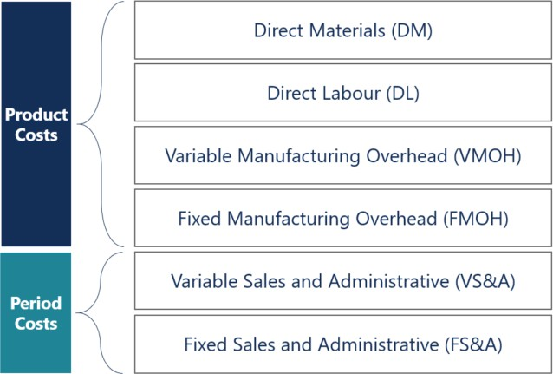

Absorption Costing
ABSORPTION COSTING:
includes ALL manufacturing costs
Process Costing (Ch. 6)
Job-Order Costing (Ch. 5)
Many different products are produced each period.
Products are manufactured to order.
The unique nature of each order requires tracing or allocating costs to each job, and maintaining cost records for each job.

Slide 6

Absorption Costing
ABSORPTION COSTING:
includes ALL manufacturing costs
Process Costing (Ch. 6)
Job-Order Costing (Ch. 5)
A company produces many units of a single, homogenous product.
One unit of product is indistinguishable from other units of product.
The identical nature of each unit of product enables assigning the same average cost per unit.

Slide 7
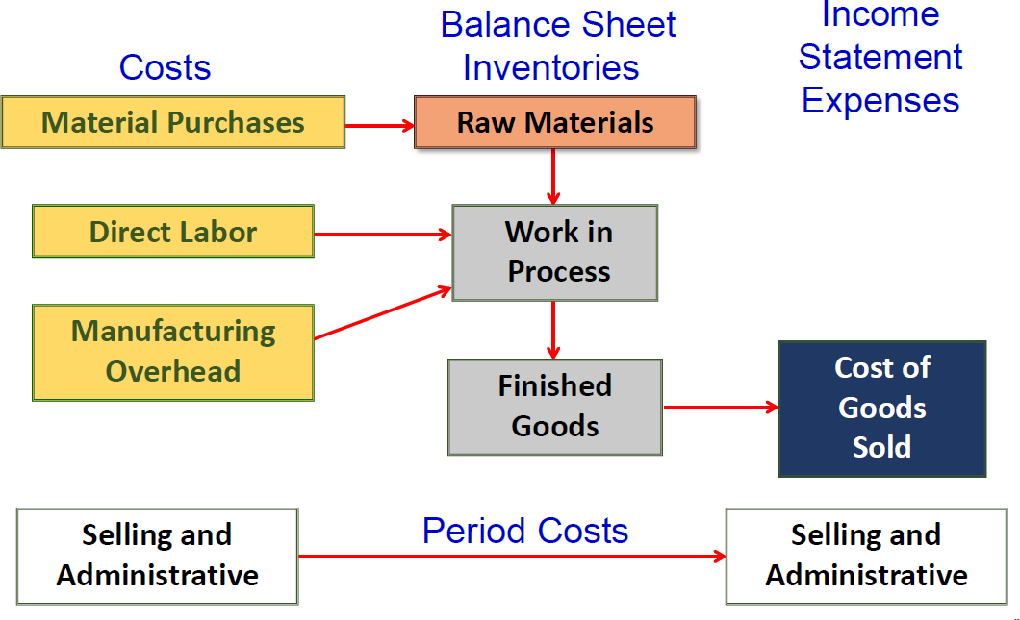
Flow of Costs
Non-Manufacturing costs (period expenses) are NOT assigned to individual jobs
Non-manufacturing costs (period expenses) are expensed in the period incurred
Class 1 Review

Slide 8



Sequential Processing Departments
Processing costs
Processing costs
Processing costs
Basic raw materials inputs
(potatoes)
Processing Department
(potato
preparation
Partially completed
Goods
(prepared
Potatoes)
Processing
Department
(cooking)
Partially completed
Goods
(cooked potato chips)
Processing
Department
(inspecting and packing)
Finished goods (packaged potatoes chips)
Item cost is determined by tracking the cost of each stage in the production process, then divide the total cost by the number of items produced

Slide 9
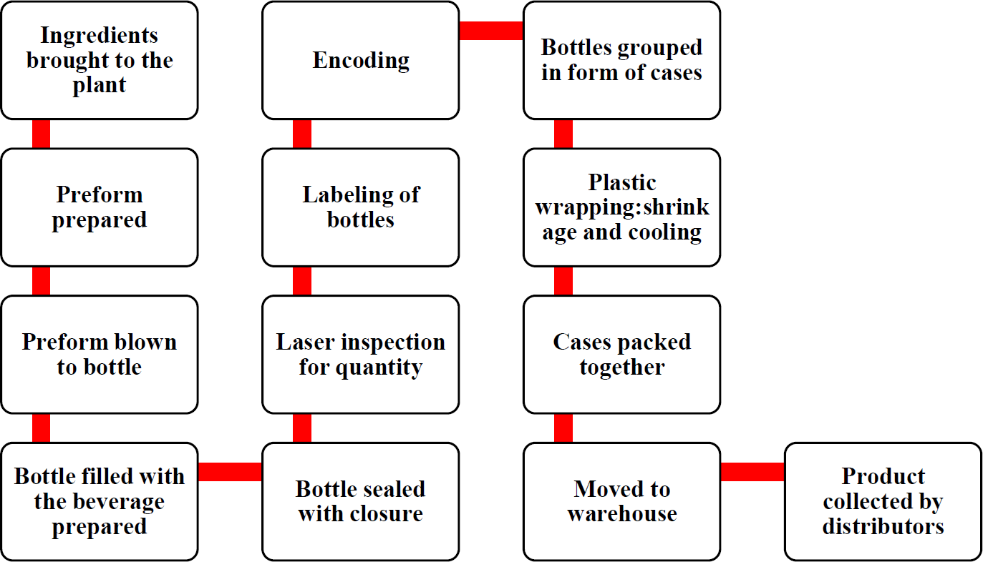

Coca Cola Process Flow
Item cost is determined by tracking the cost of each stage in the production process, then divide the total cost by the number of items produced

Slide 10

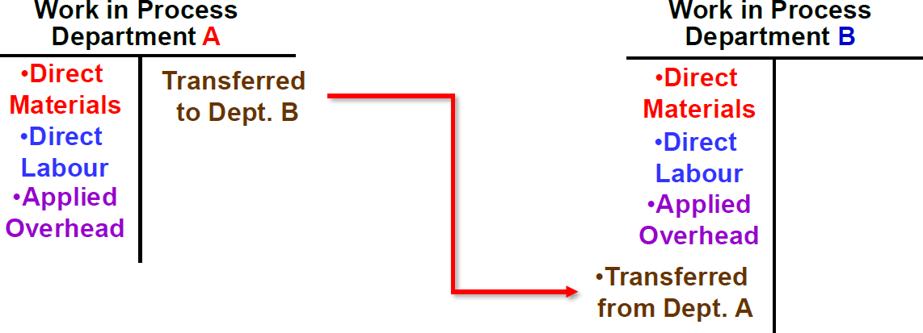
Process Costing: The Basics
Dept A: Mixing
Dept B: Bottling
Total Manufacturing Costs : Dept X
Total Units Produced
Each department has a WIP account

Slide 11
Process Costing Cost Flows
Dept A: Mixing
Dept B: Bottling
Raw Materials
WIP: Dept. A
$10,000
$2,000 | $12,000
WIP: Dept. B
$12,000
$3,000 | $15,000
Finished Goods
$10,000
$15,000
$10,000
Finished Goods of Department A become an Input to Department B

Slide 12
Quantity of Production
Material, Labour, and OH costs are known for the department
Department usually has some partially completed units in its beginning and ending inventory
Total Manufacturing Costs : Dept X
Total Units Produced
What are the total units produced???
Process Costing assigns costs to fully completed units and partially completed
units.
Partially completed units are converted to equivalent whole units or equivalent units of production (EUP).

Slide 13
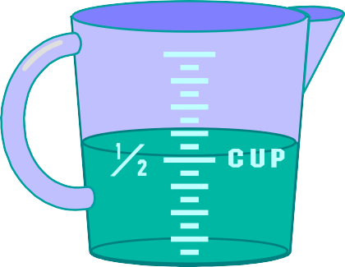


Equivalent Units of Productions
Number of whole, complete units one could obtain from the materials and effort
contained in partially completed units
Logic: Two half completed products are equivalent to one complete product.
+
=
1
Equivalent Units of Production = Number of partially completed units x Percentage
completion

Slide 14
Calculating Equivalent Units of Production
Equivalent units can be calculated two ways:
First-In, First-Out (FIFO) Method
Equivalent units and costs only relate to work done in the current period.
Makes no distinction between work done in prior or current periods
Weighted-Average (WA) Method
Blends together units and costs from the current period with units and costs
from the prior period.
Units and costs relate only to work done in current period
For this class, we only focus on Weight Avg.

Slide 15

Conversion
Direct Materials
Conversion
Direct labour and manufacturing overhead may be combined into one product cost called conversion costs
Dollar Amount
Direct
Labour
Direct Labour
Manufacturing Overhead
Type of Product Cost

Slide 16
Equivalent Units of Production
Weighted-Average Method
The weighted-average method . . .
Makes no distinction between work done in prior or current periods.
Blends together units and costs from prior and current periods.
Determines equivalent units of production for a department by adding together the number of units transferred out plus the equivalent units in ending work in process inventory.
Notes:
When we use the weighted-average method we make no distinction between work done in the prior period and work done in the current period. We blend together the units and costs from both the prior and current period.
We determine the cost per equivalent unit by dividing costs for the period by the equivalent units of production. The equivalent units of production for a department are the number of units transferred to the next department (or finished goods) plus the equivalent units in the department’s ending work in process inventory.

Slide 17
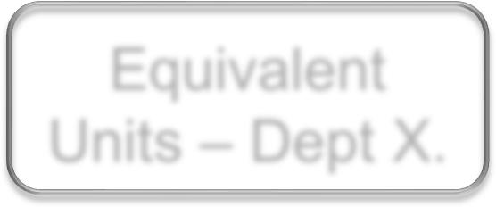

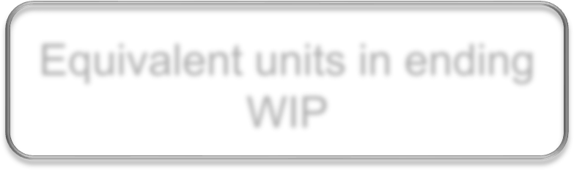
Weighed Average Method - # Units
Equivalent Units – Dept X.
Units transferred to the next department
Equivalent units in ending WIP
=
+
Computation needs to be done for each category (Material + Conversion) and each dept.
Units produced and completed during the period
Partially completed units in ending inventory

Slide 18
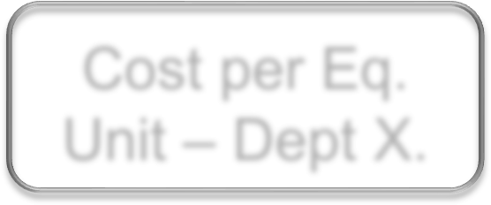

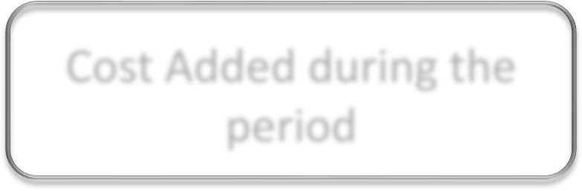
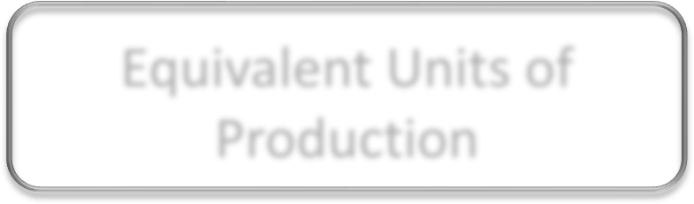
Weighted Average Method - Cost
Cost per Eq. Unit – Dept X.
Cost of Beg. WIP inventory
+
Cost Added during the period
=
Equivalent Units of Production
Blends together costs from prior and current periods
→ Hence…Weighted Average

Slide 19
Weighted Average Example
Double Diamond Skis reported the following activity in Shaping and Milling Department for the month of June:
Notes:
Let’s look at an example of calculating the cost per equivalent unit for the shaping and milling department of Double Diamond Skis. The shaping and milling department is only one of the company’s processing departments. Notice that Department A started the month of May with 200 units that are 55% complete as to materials and 30% complete as to conversion (direct labour and overhead). During the month the Department started 5,000 units into production. 4,800 units were transferred out to the next department during the month of May. At the end of May, the department had 400 units, 40% complete as to materials and 25% complete as to conversion.
Since the Department began the month with two hundred units and started five thousand units into production, we have fifty-two hundred units to account for. Of these fifty-two hundred units, forty-eight hundred were transferred out and four hundred remain in work in process inventory.

Slide 20
Weighted-Average Example
The first step in calculating the equivalent units is to identify the units completed and transferred out of the department in June (4,800 units)
Notes:
The first step in calculating the equivalent units is to identity the units completed and transferred out. In the case of the shaping and milling department, there were 4,800 units completed and transferred out. We know these units are 100% complete as to materials and conversion.

Slide 21
Weighted Average Example
The second step is to identify the equivalent units of production in ending work in process with respect to materials for the month (100 units) and add this to the 4,800 units from step one.
Notes:
The second step is to calculate the equivalent units as to materials in ending inventory. We know there are 400 units in ending inventory that are 40% complete as to materials. So we know that there are 160 equivalent units as to materials in ending working in process inventory.
For materials we add the units completed and transferred out to the equivalent units as to materials, for total units as to materials of five thousand nine hundred forty units.

Slide 22
Weighted Average Example
The third step is to identify the equivalent units of production in ending work in process with respect to conversion for the month (100 units) and add this to the 4,800 units from step one.
Notes:
The third step is to calculate the equivalent units in ending inventory as to conversion. We know there are 400 units in ending work in process inventory that are 25% complete as to conversion. So there are 100 equivalent units as to conversion in ending inventory.
For conversion, we add the units completed and transferred out to the equivalent units as to conversion to arrive at a total equivalent units as to conversion of five thousand six hundred seventy units.
We always follow these three steps when using the weighted-average method.

Slide 23
Weighted Average Example
Step 3: Compute Cost Per Equivalent Unit
Beginning work in process: 200 units
Materials: 55% complete $ 9,600
Conversion: 30% complete 5,575
Production started during June 5,000 units
Production completed during June 4,800 units
Costs added to production in June
Materials cost $ 368,600
Conversion cost $ 350,900
Ending work in process 400 units
Materials: 40% complete
Conversion: 25% complete
Notes:
Assume the following additional facts with respect to Double Diamond Skis’ Shaping and Milling Department.
The department started the month of May with two hundred units, fifty-five percent complete as to materials and thirty percent complete as to conversion (labour and overhead).
During May, five thousand units were started into production and forty-eight hundred units were completed and transferred out. You can see the costs associated with materials and conversion.
At the end of May, there were four hundred units in ending working in process inventory, forty percent complete as to materials and twenty five percent complete as to conversion.
Let’s prepare the Production Report for May. Remember, we start with the first section that computes the equivalent units as to materials and conversion.

Slide 24
Weighted-Average Example
The formula for computing the cost per equivalent unit is:
Cost of beginning work in process inventory
Cost per equivalent unit
+
Cost added during the period
=
Equivalent units of production
Notes:
We calculate the cost per equivalent unit by adding together the cost of beginning work in process inventory and the cost added during the period. We divide the total dollar amount by the number of equivalent units we previously calculated.

Slide 25
Weighted-Average Example
Compute Cost Per Equivalent
Notes:
We begin by adding the costs in beginning inventory to the costs incurred during the current period. The sum of the cost of materials and conversion equal the total cost to be accounted for during the period. Notice that we have 4,960 equivalent units as to materials, and 4,900 equivalent units as to conversion.
Let’s look at the calculation of cost per equivalent unit.

Slide 26
Weighted-Average Example
Compute Cost Per Equivalent Unit
Notes:
Part I
We have a total cost of $378,200 and 4,960 equivalent units, so the cost per equivalent unit is $76.25 for materials.
Part II
With total costs of $356,475 and total equivalent units of 4,900, we have an average cost per equivalent unit of $72.75 for conversion.
Part III
So, the total cost of materials and conversion is $149.00 per equivalent unit.
We add our materials and conversion cost per equivalent unit to get a total cost per equivalent unit during May of one hundred forty-nine dollars.
This completes the second section of the Production Report. The last section is the cost reconciliation.

Slide 27
Weighted-Average Example
Step 4: Apply the Costs
Notes:
The third step is to compute the cost of units transferred out ($366,000 for materials, $349,200 for conversion and $715,200 in total).

Slide 28
Weighted-Average Example
Step 5: Reconcile the Costs
Notes:
Computing the costs accounted for: The first step is to record the previously computed cost of ending working process inventory ($19,475). The second step is to record the previously computed cost of units transferred out ($715,200). The third step is to sum these two costs ($734,675). Notice the two totals agree indicating that all costs have been accounted for.

Slide 29
Product Costing
Let’s change the numbers…
Process Costing

Slide 30
Weighted Average Example
Double Diamond Skis reported the following activity in Shaping and Milling Department for the month of June:
Notes:
Let’s look at an example of calculating the cost per equivalent unit for the shaping and milling department of Double Diamond Skis. The shaping and milling department is only one of the company’s processing departments. Notice that Department A started the month of May with 200 units that are 55% complete as to materials and 30% complete as to conversion (direct labour and overhead). During the month the Department started 5,000 units into production. 4,800 units were transferred out to the next department during the month of May. At the end of May, the department had 400 units, 40% complete as to materials and 25% complete as to conversion.
Since the Department began the month with two hundred units and started five thousand units into production, we have fifty-two hundred units to account for. Of these fifty-two hundred units, forty-eight hundred were transferred out and four hundred remain in work in process inventory.

Slide 31
Weighted-Average Example
The first step in calculating the equivalent units is to identify the units completed and transferred out of the department in June (4,800 units)
Notes:
The first step in calculating the equivalent units is to identity the units completed and transferred out. In the case of the shaping and milling department, there were 4,800 units completed and transferred out. We know these units are 100% complete as to materials and conversion.

Slide 32
Weighted Average Example
The second step is to identify the equivalent units of production in ending work in process with respect to materials for the month (100 units) and add this to the 4,800 units from step one.
Notes:
The second step is to calculate the equivalent units as to materials in ending inventory. We know there are 400 units in ending inventory that are 40% complete as to materials. So we know that there are 160 equivalent units as to materials in ending working in process inventory.
For materials we add the units completed and transferred out to the equivalent units as to materials, for total units as to materials of five thousand nine hundred forty units.

Slide 33
Weighted Average Example
The third step is to identify the equivalent units of production in ending work in process with respect to conversion for the month (100 units) and add this to the 4,800 units from step one.
Notes:
The third step is to calculate the equivalent units in ending inventory as to conversion. We know there are 400 units in ending work in process inventory that are 25% complete as to conversion. So there are 100 equivalent units as to conversion in ending inventory.
For conversion, we add the units completed and transferred out to the equivalent units as to conversion to arrive at a total equivalent units as to conversion of five thousand six hundred seventy units.
We always follow these three steps when using the weighted-average method.

Slide 34
Weighted Average Example
Step 3: Compute Cost Per Equivalent Unit
Beginning work in process: 200 units
Materials: 55% complete $ 9,600
Conversion: 30% complete 5,575
Production started during June 5,000 units
Production completed during June 4,000 units
Costs added to production in June
Materials cost $ 368,600
Conversion cost $ 350,900
Ending work in process 1200 units
Materials: 40% complete
Conversion: 25% complete
Notes:
Assume the following additional facts with respect to Double Diamond Skis’ Shaping and Milling Department.
The department started the month of May with two hundred units, fifty-five percent complete as to materials and thirty percent complete as to conversion (labour and overhead).
During May, five thousand units were started into production and forty-eight hundred units were completed and transferred out. You can see the costs associated with materials and conversion.
At the end of May, there were four hundred units in ending working in process inventory, forty percent complete as to materials and twenty five percent complete as to conversion.
Let’s prepare the Production Report for May. Remember, we start with the first section that computes the equivalent units as to materials and conversion.

Slide 35
Weighted-Average Example
The formula for computing the cost per equivalent unit is:
Cost of beginning work in process inventory
Cost per equivalent unit
+
Cost added during the period
=
Equivalent units of production
Notes:
We calculate the cost per equivalent unit by adding together the cost of beginning work in process inventory and the cost added during the period. We divide the total dollar amount by the number of equivalent units we previously calculated.

Slide 36
Weighted-Average Example
Compute Cost Per Equivalent
Notes:
We begin by adding the costs in beginning inventory to the costs incurred during the current period. The sum of the cost of materials and conversion equal the total cost to be accounted for during the period. Notice that we have 4,960 equivalent units as to materials, and 4,900 equivalent units as to conversion.
Let’s look at the calculation of cost per equivalent unit.

Slide 37
Weighted-Average Example
Compute Cost Per Equivalent Unit
Notes:
Part I
We have a total cost of $378,200 and 4,960 equivalent units, so the cost per equivalent unit is $76.25 for materials.
Part II
With total costs of $356,475 and total equivalent units of 4,900, we have an average cost per equivalent unit of $72.75 for conversion.
Part III
So, the total cost of materials and conversion is $149.00 per equivalent unit.
We add our materials and conversion cost per equivalent unit to get a total cost per equivalent unit during May of one hundred forty-nine dollars.
This completes the second section of the Production Report. The last section is the cost reconciliation.

Slide 38
Weighted-Average Example
Step 4: Apply the Costs
Notes:
The third step is to compute the cost of units transferred out ($366,000 for materials, $349,200 for conversion and $715,200 in total).

Slide 39
Weighted-Average Example
Step 5: Reconcile the Costs
Notes:
Computing the costs accounted for: The first step is to record the previously computed cost of ending working process inventory ($19,475). The second step is to record the previously computed cost of units transferred out ($715,200). The third step is to sum these two costs ($734,675). Notice the two totals agree indicating that all costs have been accounted for.

Slide 40
Any Questions?

